Slide 1
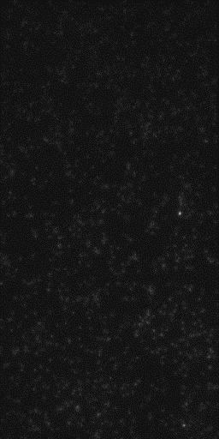
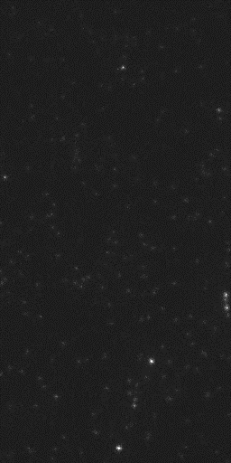
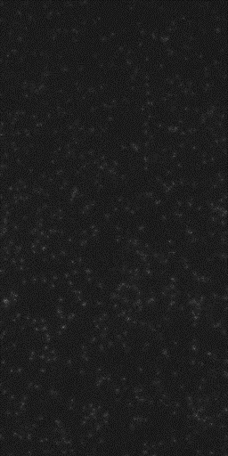
Single Round of Size Exclusion Chromatography
SNAREs only
1 µM α-syn
10 µM α-syn

